Slide 1
Jenkins
Rohit Vignesh 20-04-22

Slide 2
Introduction to Jenkins
Jenkins is an open-source automation tool written in java, which can be used to automate all sorts of tasks related to building, testing, and delivering or deploying software
The Jenkins project was originally named Hudson.
Builds can be triggered upon pushed commits, by scheduling corn jobs, by specific URL, after other builds in queue completed.
https://www.jenkins.io/doc/

Slide 3
Feature of Jenkins
Continuous Integration and Continuous Delivery
Easy installation
Easy configuration
Plugins
Extensible

Slide 4
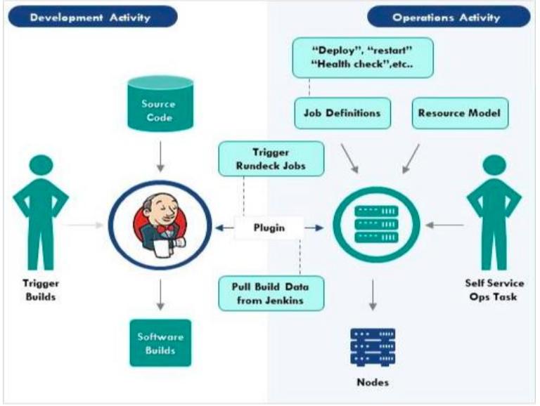
Jenkins Architecture
Jenkins is server-based system that runs in servlet containers such as Apache Tomcat

Slide 5
Jenkins installation
cd /etc/yum.repos.d/
sudo sed -i 's/mirrorlist/#mirrorlist/g' /etc/yum.repos.d/CentOS-*
sudo sed -i 's|#baseurl=http://mirror.centos.org|baseurl=http://vault.centos.org|g' /etc/yum.repos.d/CentOS-*
sudo yum install wget
sudo wget -O /etc/yum.repos.d/jenkins.repo https://pkg.jenkins.io/redhat-stable/jenkins.repo
sudo rpm --import https://pkg.jenkins.io/redhat-stable/jenkins.io.key
sudo yum install fontconfig java-11-openjdk
sudo yum install Jenkins
sudo systemctl start Jenkins
sudo systemctl status Jenkins
sudo cat /var/lib/jenkins/secrets/initialAdminPassword

Slide 6
Cont..
Java and GIT installation commands
sudo yum install java-11-*
sudo yum install git
Maven installation steps
wget https://dlcdn.apache.org/maven/maven-3/3.8.5/binaries/apache-maven-3.8.5-bin.tar.gz
tar -xvf apache-maven-3.8.5-bin.tar.gz
sudo mv apache-maven-3.8.5 /opt/maven
sudo ln -s /opt/maven/bin/mvn /usr/bin/mvn
Clone sample project and build in Jenkin server
git clone “your repo url”
cd helloworldweb/
mvn clean
mvn clean package - create war file

Slide 7
Tomcat server installation
sudo yum install wget git
sudo yum install java-11-openjdk
wget https://dlcdn.apache.org/tomcat/tomcat-10/v10.0.20/bin/apache-tomcat-10.0.20.tar.gz
tar -xvf apache-tomcat-10.0.20.tar.gz
sudo mv apache-tomcat-10.0.20 /opt/tomcat
sudo chown -R centos /opt/
sudo chgrp -R centos /opt/
cd /opt/tomcat/bin
./startup.sh
http://52.24.55.250:8080/

Slide 8
Screenshots

Slide 9
Thank you

